Slide 1
Title: Histogram Equalization Subtitle: A Technique for Image Enhancement

Slide 2
Histogram Equalization
Histogram Equalization is a technique used in image processing to enhance the contrast of an image.
The idea is to redistribute the intensity levels (pixel values) of the image so that the range of intensities (brightness levels) is more evenly spread out, especially in images withpoor contrast.
This makes it easier to see details in dark or bright areas of the image.

Slide 3
How Histogram Equalization Works
1. Histogram: An image’s histogram is a graphical representation of the distribution of pixel intensities (brightness levels) in the image. It shows how many pixels in the image have a particular intensity value.
2. Cumulative Distribution Function (CDF): The CDF is calculated by accumulatin the frequency of each intensity level in the histogram.
3. Mapping: The pixel values are mapped to new intensity values based on the CDF, which spreads out the most frequent pixel values over the full range of availableintensities.

Slide 4
Step-by-Step Process:
1. Find the Histogram: First, compute the histogram of the image. This shows the
frequency of each pixel intensity (from 0 to 255 for an 8-bit grayscale image).
2. Compute the CDF: Calculate the cumulative distribution function of the histogram.
This function represents the cumulative sum of pixel frequencies up to each intensity level.
3. Normalize the CDF: The CDF is normalized by dividing each value by the total
number of pixels in the image. This scales the CDF values between 0 and 1.
4. Map the Pixel Values: For each pixel intensity, map it to a new value based on the
normalized CDF. This spreads the pixel values over the entire intensity range (0–255),
resulting in better contrast.
5. Recreate the Image: Finally, the image is transformed by replacing each pixel value
with its corresponding new value, creating an enhanced image.

Slide 5
Example of Histogram Equalization:
Consider a grayscale image where most pixel values are clustered around a lower intensity range, making it look dark and lacking contrast.
Original Histogram:
makefile
Copy
Intensity: 0 50 100 150 200 250
Frequency: 10 30 100 50 10 5
This histogram shows that most pixels have values around 100–150, meaning the image is mostly dark with little contrast.

Slide 6
After Histogram Equalization:
The histogram will be adjusted such that the intensity values are spread more evenly across the entire 0-255 range.
After equalization
makefile
Copy
Intensity: 0 50 100 150 200 250
Frequency: 5 10 30 100 50 10
The pixel values will now span a wider range, improving the contrast and making both dark and bright areas more distinguishable.

Slide 7
Resulting Image:
Before: A dark, poorly contrasted image.
After: A more evenly distributed image with enhanced contrast, where details in both the dark and light areas more clearly.

Slide 8
When to Use Histogram Equalization:
• Low-Contrast Images: Images where the features are hard to distinguish due to poor contrast (e.g., an image taken in dim lighting).
• Medical Imaging: Enhancing medical scans (like X-rays) to make fine details more visible.
• Satellite Imaging: Improving the visibility of terrain or structures in satellite images.

Slide 9
Benefits of Histogram Equalization:
• Improved Contrast: Increases the contrast, especially in images with poor visibility of details.
• Better Feature Detection: Makes it easier for algorithms (like object detection or edge detection) to find features in the image.
• Visual Clarity: Makes the image more visually clear to the human eye.

Slide 10
Limitations:
• Over-enhancement: If applied to an already well-contrasted image, it might introduce noise and make the image look unnatural.
• Color Images: Histogram equalization works best on grayscale images. For color images, it can be applied to individual channels (R, G, B), but it may result in unnatural color shifts.

Slide 11
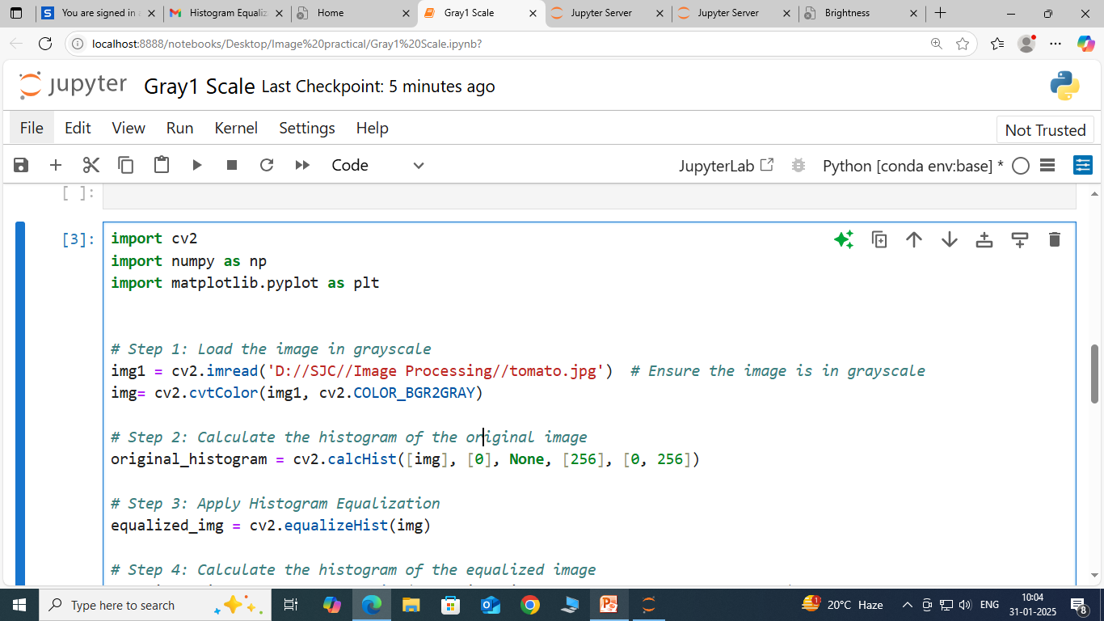

Slide 12
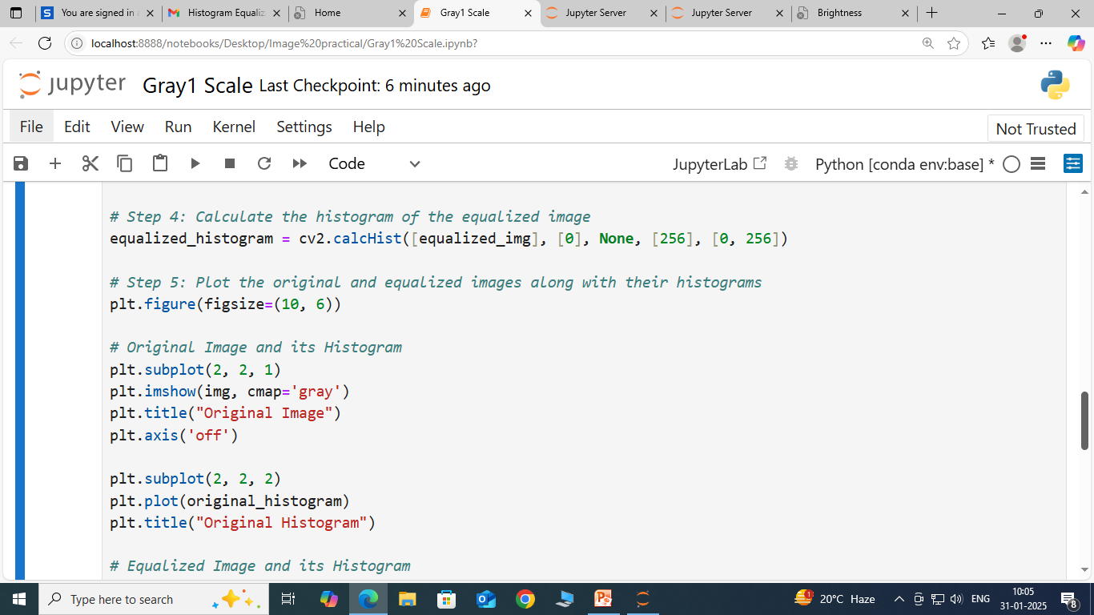

Slide 13
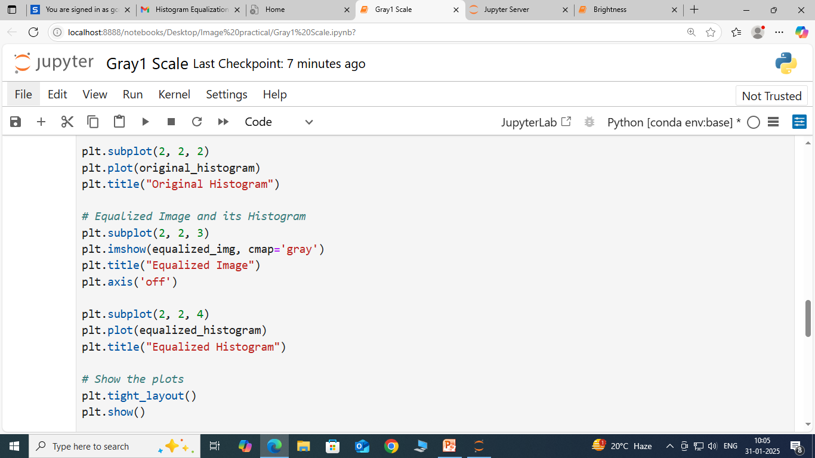

Slide 14
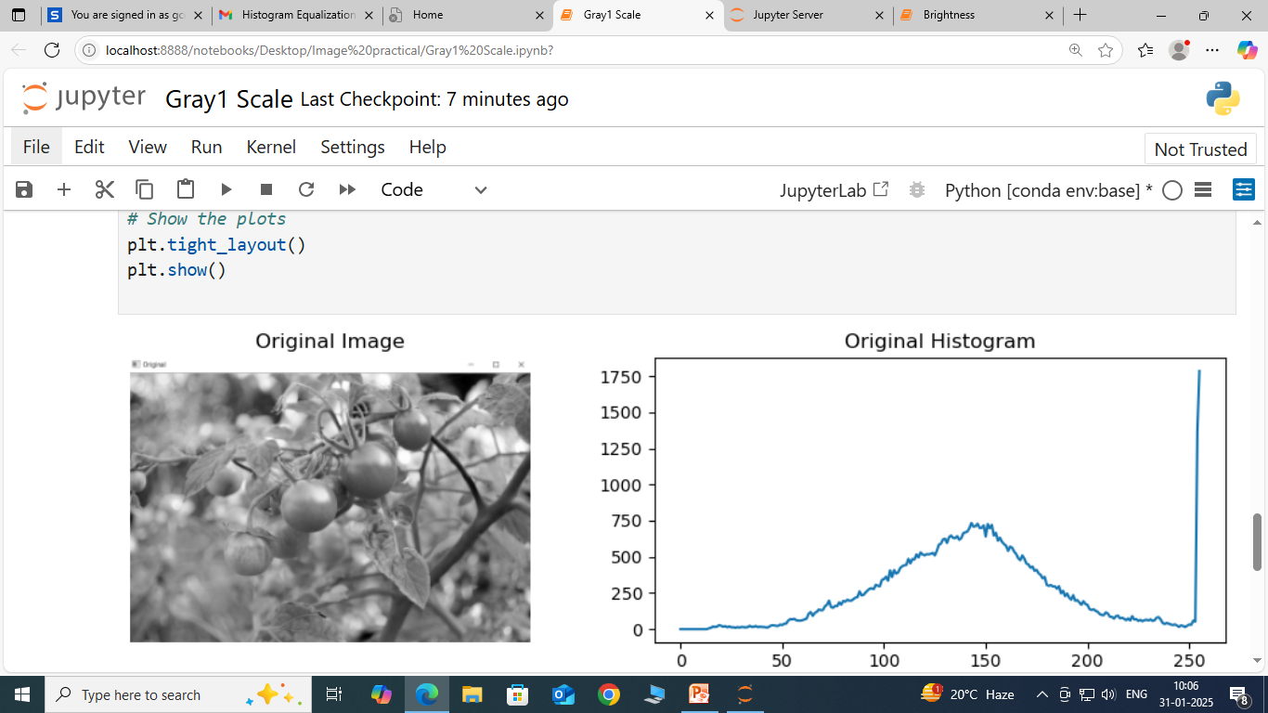

Slide 15
